Slide 1


PYTHON
Lecture 48

Slide 2

Today’s Agenda
Operator Overloading
What Is Operator Overloading
How To Perform Operator Overloading
List Of Operators Which Can Be Overloaded
Reverse Arithmetic Operators

Slide 3
What Is Operator Overloading?
Operator overloading means redefining existing operators in Python to work on objects of our classes.
For example, a + operator is used to add the numeric values as well as to concatenate the strings.
That’s because operator + is overloaded for int class and str class.

Slide 4
What Is Operator Overloading?
But we can give extra functionality to this + operator and use it with objects of our own class.
This method of giving extra functionality to the operators is called operator overloading.

Slide 5
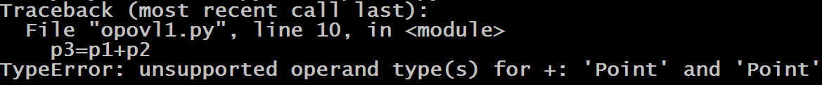
Guess The Output ?
class Point:
def __init__(self,x,y):
self.x=x
self.y=y
def __str__(self):
return f"x={self.x},y={self.y}"
p1=Point(10,20)
p2=Point(30,40)
p3=p1+p2
print(p3)
Output:
Why did TypeError occur?
TypeError was raised since Python didn't know how to add two Point objects together.

Slide 6
How To Perform Operator Overloading?
There is an underlying mechanism related to operators in Python.
The thing is when we use operators, a special function or magic function is automatically invoked that is associated with that particular operator.

Slide 7
How To Perform Operator Overloading?
For example, when we use + operator, the magic method __add__ is automatically invoked in which the operation for + operator is defined.
So by changing this magic method’s code, we can give extra meaning to the + operator.

Slide 8
Example
class Point:
def __init__(self,x,y):
self.x=x
self.y=y
def __add__(self,other):
x=self.x+other.x
y=self.y+other.y
p=Point(x,y)
return p
def __str__(self):
return f"x={self.x},y={self.y}“
p1=Point(10,20)
p2=Point(30,40)
p3=p1+p2
print(p3)
Output:

Slide 9
Explanation
When we wrote p1 + p2, then Python did the following:
It searched for the magic method __add__() in our Point class since the left side operand i.e. p1 is of Point class.
After finding __add___() in our class Python converted our statement p1+p2 to p1.__add__(p2) which in turn is Point.__add__(p1,p2).
So p1 is passed as self and p2 is passed to other
Finally addition was done and a new object p was returned which was copied to p3

Slide 10

Guess The Output
class Point:
def __init__(self,x,y):
self.x=x
self.y=y
def __add__(self,other):
x=self.x+other.x
y=self.y+other.y
p=Point(x,y)
return p
def __str__(self):
return f"x={self.x},y={self.y}"
p1=Point(10,20)
p2=Point(30,40)
p3=p1+p2
print(p3)
p4=p1+p2+p3
print(p4)
Output:

Slide 11
Exercise
Write a program to create a class called Distance having 2 instance members called feet and inches . Provide following methods in Distance class
__init___() : This method should accept 2 arguments and initialize feet and inches with it
__str__(): This method should return string representation of feet and inches
__add___() : This method should add 2 Distance objects and return another Distance object as the result. While adding if sum of inches becomes >=12 then it should be appropriately converted to feet

Slide 12

Solution
d1=Distance(10,6)
d2=Distance(8,9)
d3=d1+d2
print(d1)
print(d2)
print(d3)
class Distance:
def __init__(self,feet,inches):
self.feet=feet
self.inches=inches
def __add__(self,other):
feet=self.feet+other.feet
inches=self.inches+other.inches
if inches>=12:
feet=feet+inches//12
inches=inches%12
d=Distance(feet,inches)
return d
def __str__(self):
return f"feet={self.feet},inches={self.inches}“
Output:

Slide 13
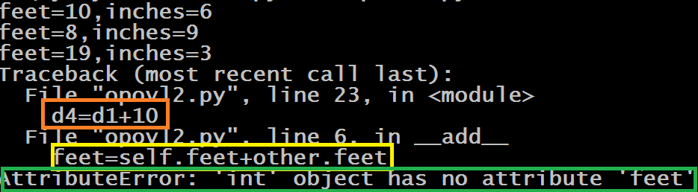
Guess The Output ?
d1=Distance(10,6)
d2=Distance(8,9)
d3=d1+d2
print(d1)
print(d2)
print(d3)
d4=d1+10
print(d4)
class Distance:
def __init__(self,feet,inches):
self.feet=feet
self.inches=inches
def __add__(self,other):
feet=self.feet+other.feet
inches=self.inches+other.inches
if inches>=12:
feet=feet+inches//12
inches=inches%12
d=Distance(feet,inches)
return d
def __str__(self):
return f"feet={self.feet},inches={self.inches}“
Output:
Why did AttributeError occur ?
This is because Python is trying to use the int object as Distance object and since int class has no feet data member the code is throwing AttributeError

Slide 14
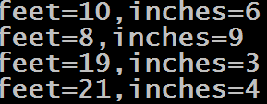
Solution
d1=Distance(10,6)
d2=Distance(8,9)
d3=d1+d2
print(d1)
print(d2)
print(d3)
d4=d1+10
print(d4)
class Distance:
def __init__(self,feet,inches):
self.feet=feet
self.inches=inches
def __add__(self,other):
if isinstance(other,Distance):
feet=self.feet+other.feet
inches=self.inches+other.inches
else:
feet=self.feet+other
inches=self.inches+other
if inches>=12:
feet=feet+inches//12
inches=inches%12
d=Distance(feet,inches)
return d
def __str__(self):
return f"feet={self.feet},inches={self.inches}“
Output:
We have used isinstance() function to determine whether the argument other is of type Distance or not . If it is of type Distance we perform usual addition logic , otherwise we simply add the argument other to self.feet and self.inches as int value

Slide 15
List Of Arithmetic Operator For Overloading
Operator | Expression | Internally
Addition | p1 + p2 | p1.__add__(p2)
Subtraction | p1 - p2 | p1.__sub__(p2)
Multiplication | p1 * p2 | p1.__mul__(p2)
Power | p1 ** p2 | p1.__pow__(p2)
Division | p1 / p2 | p1.__truediv__(p2)
Floor Division | p1 // p2 | p1.__floordiv__(p2)
Remainder (modulo) | p1 % p2 | p1.__mod__(p2)

Slide 16
Exercise
Write a program to create a class called Book having 2 instance members called name and price . Provide following methods in Book class
__init__() : This method should accept 2 arguments and initialize nameand price with it
__str__(): This method should return string representation of name and price
__add__() : This method should add price of 2 Books and return the total price

Slide 17

Solution
b1=Book("Mastering Python",300)
b2=Book("Mastering Java",500)
print(b1)
print(b2)
print("Total price of books is:",b1+b2)
class Book:
def __init__(self,name,price):
self.name=name
self.price=price
def __add__(self,other):
totalprice=self.price+other.price
return totalprice
def __str__(self):
return f"name={self.name},price={self.price}"
Output:

Slide 18
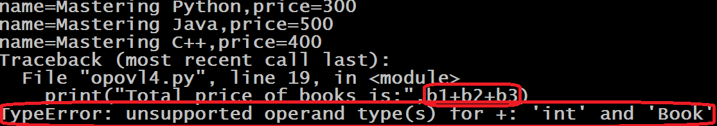
Guess The Output ?
b1=Book("Mastering Python",300)
b2=Book("Mastering Java",500)
b3=Book("Mastering C++",400)
print(b1)
print(b2)
print(b3)
print("Total price of books is:",b1+b2+b3)
class Book:
def __init__(self,name,price):
self.name=name
self.price=price
def __add__(self,other):
totalprice=self.price+other.price
return totalprice
def __repr__(self):
return f"name={self.name},price={self.price}"
Output:

Slide 19
Why Did TypeError Occur ?
TypeError occurred because Python evaluated the statement b1+b2+b3 as follows:
At first it solved b1+b2 , which became b1.__add__(b2).
So Python called __add__() method of Book class since the left operand is b1 which is object of class Book
This call returned the total price of b1 and b2 which is 800.
Now Python used 800 as the calling object and b3 as argument so the call became 800.__add__(b3).
So Python now looks for a method __add__() in int class which can add an int and a book but it could not find such a method in int class which can take Book object as argument .
So the code threw TypeError

Slide 20
What Is The Solution To This Problem ?
The solution to this problem is to provide reverse special methods in our class.
The standard methods like __add__(),__sub__() only work when we have object of our class as left operand .

Slide 21
What Is The Solution To This Problem ?
But they don’t work when we have object of our class on right side of the operator and left side operand is not the instance of our class.
For example : obj+10 will call __add__() internally, but 10+obj will not call __add__()

Slide 22
What Is The Solution To This Problem ?
Therefore, to help us make our classes mathematically correct, Python provides us with reverse/reflected special methods such as __radd__(), __rsub__(), __rmul__(), and so on.
These handle calls such as x + obj, x - obj, and x * obj, where x is not an instance of the concerned class.

Slide 23
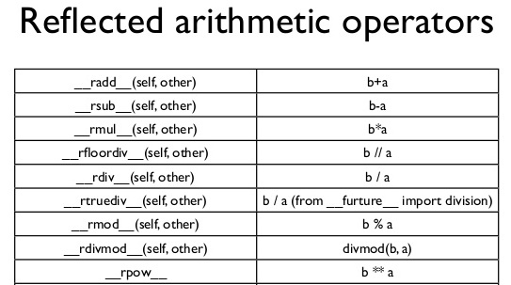
Reflected Operators

Slide 24
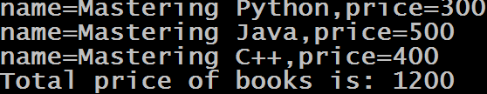
Modified Example
b1=Book("Mastering Python",300)
b2=Book("Mastering Java",500)
b3=Book("Mastering C++",400)
print(b1)
print(b2)
print(b3)
print("Total price of books is:",b1+b2+b3)
class Book:
def __init__(self,name,price):
self.name=name
self.price=price
def __add__(self,other):
totalprice=self.price+other.price
return totalprice
def __radd__(self,other):
totalprice=self.price+other
return totalprice
def __str__(self):
return f"name={self.name},price={self.price}"
Output:

Slide 25
List Of Relational Operator For Overloading
Operator | Expression | Internally
Less than | p1 < p2 | p1.__lt__(p2)
Less than or equal to | p1 <= p2 | p1.__le__(p2)
Equal to | p1 == p2 | p1.__eq__(p2)
Not equal to | p1 != p2 | p1.__ne__(p2)
Greater than | p1 > p2 | p1.__gt__(p2)
Greater than or equal to | p1 >= p2 | p1.__ge__(p2)

Slide 26
Exercise
Write a program to create a class called Distance having 2 instance members called feet and inches . Provide following methods in Distance class
__init___() : This method should accept 2 arguments and initialize feet and inches with it
__str__(): This method should return string representation of feet and inches
__eq___() : This method should compare 2 Distance objects and return True if they are equal otherwise it should return False

Slide 27

Solution
d1=Distance(0,12)
d2=Distance(1,0)
print(d1)
print(d2)
if d1==d2 :
print("Distances are equal")
else:
print("Distances are not equal")
class Distance:
def __init__(self,feet,inches):
self.feet=feet
self.inches=inches
def __eq__(self,other):
x=self.feet*12+self.inches
y=other.feet*12+other.inches
if x==y:
return True
else:
return False
def __str__(self):
return f"feet={self.feet},inches={self.inches}“
Output:

Slide 28
List Of Shorthand Operator For Overloading
Operator | Expression | Internally
-= | p1-=p2 | p1.__isub__(p2)
+= | p1+=p2 | p1.__iadd__(p2)
*= | p1*=p2 | p1.__imul__(p2)
/= | p1/=p2 | p1.__idiv__(p2)
//= | p1//=p2 | P1.__ifloordiv__(p2)
%= | p1%=p2 | p1.__imod__(p2)
**= | p1**=p2 | p1.__ipow__(p2)

Slide 29
List Of Special Functions/Operators For Overloading
Function/Operator | Expression | Internally
len( ) | len(obj) | obj.__len__(self)
[ ] | obj[0] | obj.__getitem__(self,index)
in | var in obj | obj.__contains__(self,var)
str( ) | str(obj) | obj.__str__(self)

